Slide 1
THE
EUROPEAN
Academy of ENGLISH Language & COMPUTER Education

Slide 2
Address
1st Floor, Luxmi Complex, Near Railway Crossing
Jhumri telaiya, Koderma
Mob:- 82929-84929

Slide 3
COURSES
1. D.C.A.
3 Months
2. D.T.P.
3 Months
3. Tally
3 Months
4. D.F.A.
3 Months

Slide 4
Center Head
Krishna Kumar

Slide 5
Faculty
1. Mr. Mithun Singh
2. Deepak Singh
3. Kaundaliya Prasad
4. Gulista frahan

Slide 6
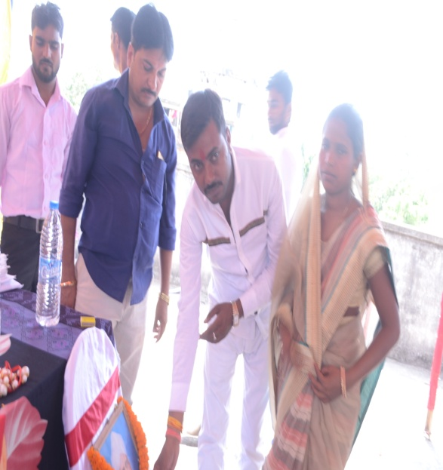
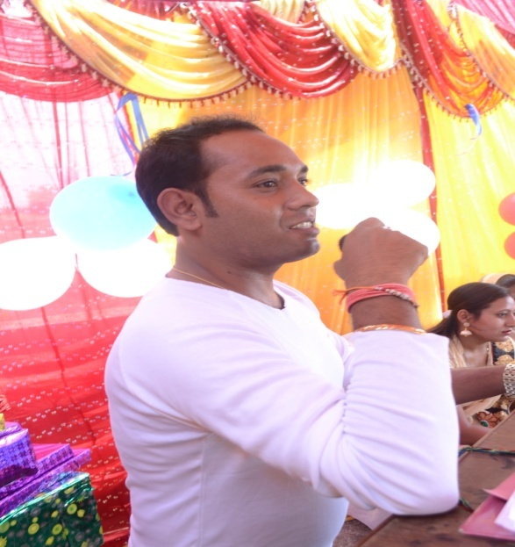
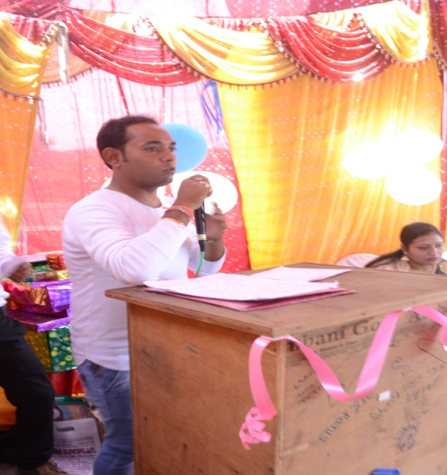
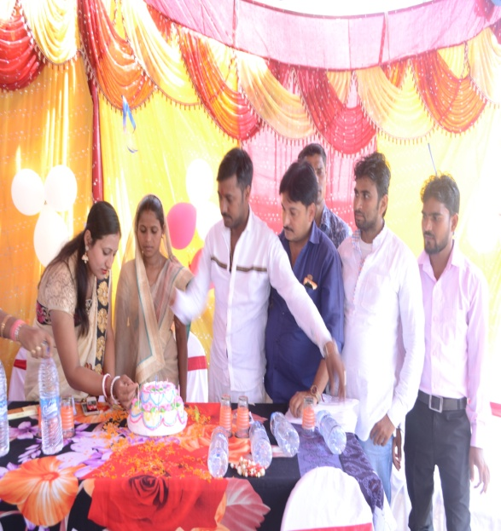
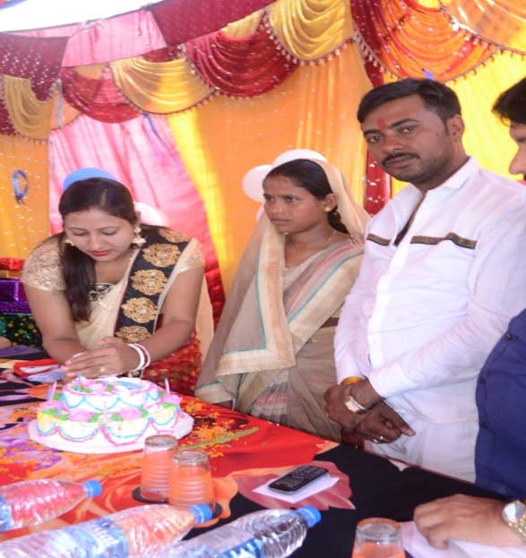
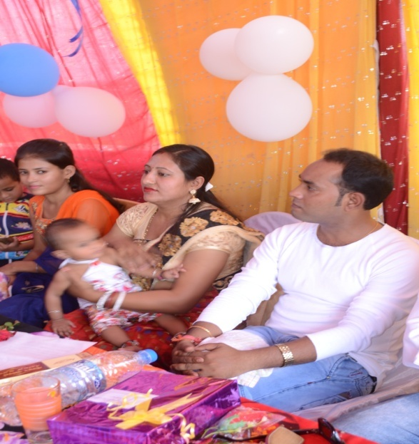
Picture Gallary

